Slide 1
Thinking about the Central Limit Theorem and the Normal Curve
R. Garner, DePaul University

Slide 2
Why think about it at all?
The Central Limit Theorem is about the distribution of sample outcomes—for example, sample means—when the samples are drawn randomly from a population.
The sample means will NOT be identical, and they will NOT all be equal to the population mean.
The Central Limit Theorem tells us how much variability we can expect to find in the sample outcomes.

Slide 3
Why do we care?
Because if there is too much variability in the sample outcomes—if they are likely to be really different from the population value—then any sample we draw might have an outcome that would mislead us about the population.
We could draw a seriously mistaken conclusion from the sample result.
Fortunately, that is NOT PROBABLE.

Slide 4
What does the Central Limit Theorem say?
It says that the sample means fall in a definite pattern.
We can represent it by a smoothed histogram.
Sample means near the population mean are more likely than sample means that are distant from the population mean.
The smoothed histogram looks like the normal curve: samples with sample means near the population mean are more frequent than samples with “distant” means.

Slide 5
Sampling error has a normal distribution
“Sampling error” is the variability of sample outcomes. They are not identical to the population outcome and so most of them are “errors”—they miss the population value.
The normal distribution of sampling error shows us that most of the “errors” are probably not very large—most of the sample outcomes are near the population value.

Slide 6
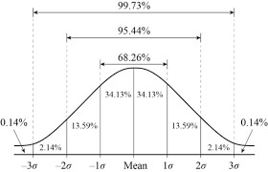
Normal Curve

Slide 7
More about the normal curve as the distribution of sampling error
The sampling distribution represents all the sample outcomes.
Each case of this distribution is a simple random sample.
Samples with outcomes near the population value are more frequent—more likely.
The mean of all the sample outcomes is equal to the population value.
For example, the mean of the sample means is equal to the population mean.

Slide 8
Example: Thought Experiment
Let’s say we are trying to find the mean height of Canadian women.
We take a bunch of random samples, and we can make a list of the sample means—values such as 160 cm, 158.9 cm, 170 cm, 165 cm, and so on.
We create a histogram with the horizontal axis charting the SAMPLE MEAN HEIGHT and the vertical axis charting FREQUENCY—the height of the bars shows how many samples had the mean height marked on the horizontal axis?

Slide 9
Thought Experiment (continued)
After we drew a lot of samples and charted how many of them had each sample mean that we indicated on the horizontal axis, we would find that we charted a normal curve.
Samples with means NEAR the population mean would be more frequent—these frequencies are shown by bars that form a hump at the middle
Samples with means DISTANT from the population mean would be less frequent—little stubby bars forming the tails at either end.

Slide 10
Thought Experiment (continued)
Eventually we would find that the MEAN OF THE SAMPLE MEANS would be equal to the population mean.
In this example, the mean height of Canadian women is 164 cm (about 65 inches). That is μ, the population mean.
If we took all of our samples, found the mean height for each sample, and then found the MEAN OF THE SAMPLE MEANS, that mean would be 164 cm.

Slide 11
Normal curve, known probabilities
Because the distribution of sample means is normally distributed, we KNOW that:
Slightly more than 2/3 (actually, 68%) of our sample means are within one standard deviation of the population mean.
About 95% of our sample means are within two standard deviations of the population mean.

Slide 12
What’s the standard deviation?
Yes, that is a good question!
Because the standard deviation of the sampling distribution is NOT the same as the standard deviation of the underlying variable distribution for the population (which in this case, is the height of Canadian women).
The SD of the sampling distribution is called the standard error.
It is a considerably smaller number than the population SD, and it depends on sample size!

Slide 13
Computing the standard error
The standard error tells us how much variability there is in the sample outcomes.
We compute it as: σ/sqrt(n).
The population standard deviation DIVIDED BY THE SQUARE ROOT OF SAMPLE SIZE.
This makes sense intuitively—the standard error gets smaller when we take larger samples.

Slide 14
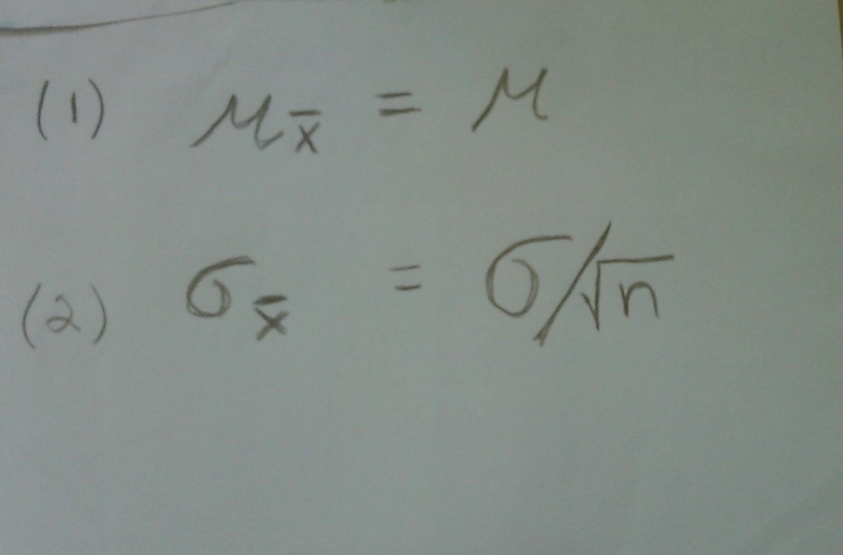
Mean and SD of the sampling distribution

Slide 15
The formulas
Formula (1) says: the mean of the sample means (“mu X-bar”) is equal to the population mean (“mu”).
Formula (2) says: the standard deviation of the sampling distribution of means (the standard error or “sigma X-bar”) is equal to the population standard deviation (“sigma”) divided by sample size.
Notice the subscripted X-bar on the left side in each formula—that refers to the distribution of sample means.

Slide 16
Estimating the standard error
Typically we don’t know the standard deviation for the population (if we knew it, we would probably know the mean, and so why bother with sampling?)
So we have to estimate it by the sample standard deviation.
Standard error is estimated by:
s/sqrt(n) (sample standard deviation divided by the square root of sample size)

Slide 17
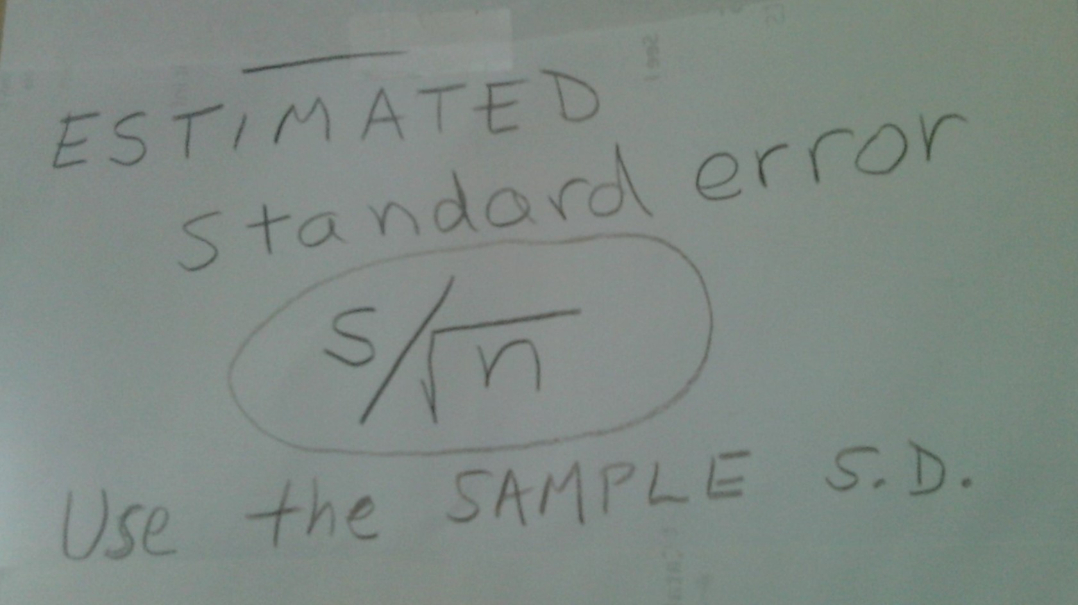
Formula for the estimated standard error

Slide 18
Larger sample size reduces the standard error
Let’s say we found a sample standard deviation of 6 cm (about 2.4 inches). The standard error involves dividing this value by sample size:
SE for a sample of 36: 6/6 = 1
SE for a sample of 100: 6/10 = .6
SE for a sample of 400: 6/20 = .3
SE for a sample of 900: 6/30 = .2
OK you get the picture: the bigger the sample, the smaller the standard error.

Slide 19
Back to the normal curve histogram
The standard error is the standard deviation of the histogram that shows sample outcomes.
68% of the samples have outcomes within one standard error of the population value.
95% of the samples have outcomes within two standard errors of the population value.
This is a mathematical statement, based on the computation of probabilities for random samples. If our sampling is truly random, this is the distribution of sample outcomes.

Slide 20
Practical consequences
By the Central Limit Theorem, we know that most sample outcomes (such as sample means) will not be very far from the population value we are trying to estimate.
For our height exercise, if our sample size is 100, more than 2/3 of sample means will be within one standard error (.6 cm) plus or minus from the population value; and 95% will be within two standard errors (1.2 cm) plus or minus from the population mean. This sample size is likely to give us a pretty good estimate!
It is unlikely (low probability) that samples of 100 would give us a really mistaken estimate of the mean height of Canadian women—one that is “off” by many centimeters.

Slide 21
A few final points
Because we had to estimate the standard deviation from the sample, we should look at the t-distribution, rather than the Z-distribution. The t-distribution is similar to the normal one, just a little lower at the middle hump and a little “fatter” in the tails.
Heights happen to be more or less normally distributed (“near normal”), but it does not matter if the underlying variable is normally distributed or not. The sampling distribution (with random samples) will be normal.

Slide 22
Sample size and the t-distribution
For small sample sizes, we should use the t-distribution.
If n > 120, the t-distribution and the Z-distribution (normal curve) of sampling error are essentially identical.

Slide 23
Key Terms
Central Limit Theorem; sampling distribution; sampling error; normal curve; histogram; mean of the population (parameter); mean of the sample means; standard deviation of the sample and of the population; standard deviation of the sampling distribution (standard error); estimated standard error; t-distribution; discrepant/distant vs. near; probabilities.

